Slide 1
Class

Slide 2
What is the class?
A class is a blueprint for creating objects. Just like a house blueprint defines structure, a class defines what data and actions an object will have.

Slide 3
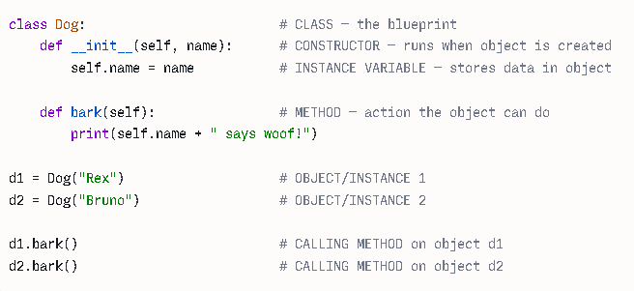

Slide 4
We have class Dog

Slide 5
Constructor

Slide 6
Constructor
Method

Slide 7
Constructor
Method
We are creating object d1 and d2
Calling Method on object d1 and d2
It is similar to “hello”.upper() which we understood in strings

Slide 8
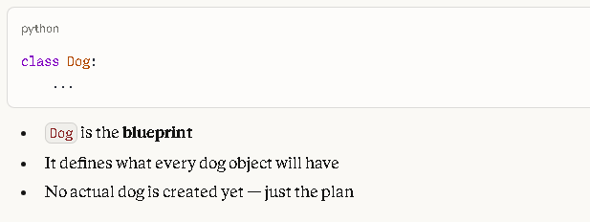
1. What is the Class?
Within the class we will write the
Method
Now what is Method vs function: Methods are createds within the class
And functions are isolated logical
group of code.

Slide 9
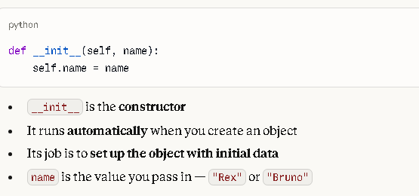
2. What is the Constructor?
A constructor in Python is a special method __init__ that is automatically called when an object is created. It is used to initialize the object’s attributes (variables) with initial values.
So , Whenever write
d1 = Dog(“Rex”) then it creates
the object d1 and constructor
(__init__(d1, "Rex"))
Will be called
Whenever you write
d2 = Dog(“Bruno”) then it creates
the object d1 and constructor
(__init__(d1, “Bruno"))
Will be called
self.name is an instance variable
It belongs to that specific object only
d1.name = "Rex" — only for d1
d2.name = "Bruno" — only for d2

Slide 10
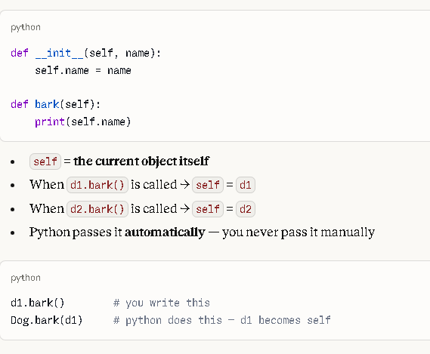
3. What is self?
When we run
d1 = dog(“Rex”)
Here d1 is the object
So now def _init_(d1,”Rex”):
self.name = “Rex”
Now when you execute, Dog.bark(d1)
In this we are calling Class Dog
Where we are calling bark as method
And d1 as object
So request will go to Dog class
Here , bark(d1) #self = d1
print(“Rex”)

Slide 11
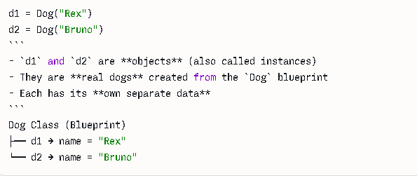
4. What is an Object / Instance?
This is the object1 we are creating
This is the object2 we are creating

Slide 12
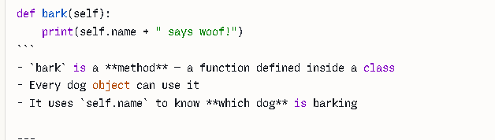
4. What is Method
When you run d1.bark()
You are calling the method bark using the object d1

Slide 13
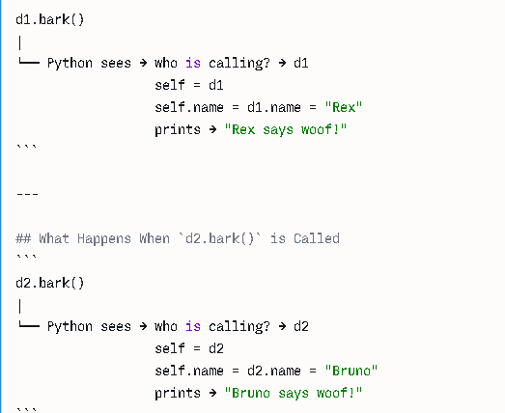
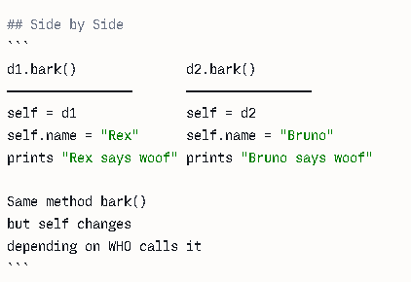
## What Happens When `d1.bark()` is Called

Slide 14
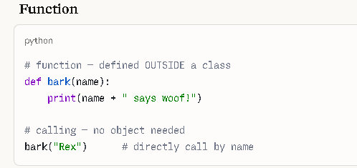
METHOD Vs FUNCTION
Function → stands ALONE, outside a class
Method → lives INSIDE a class, belongs to an object

Slide 15
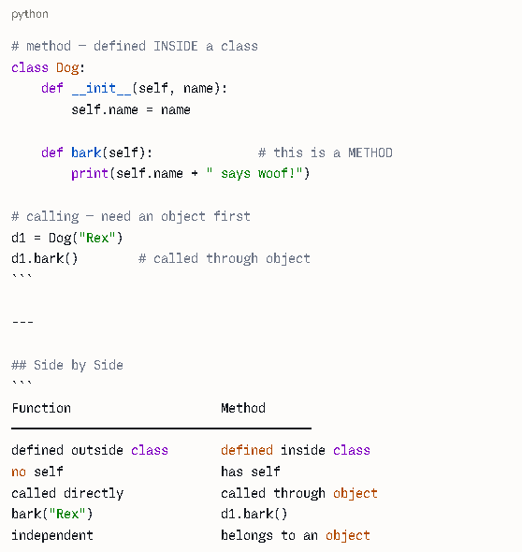

Slide 16
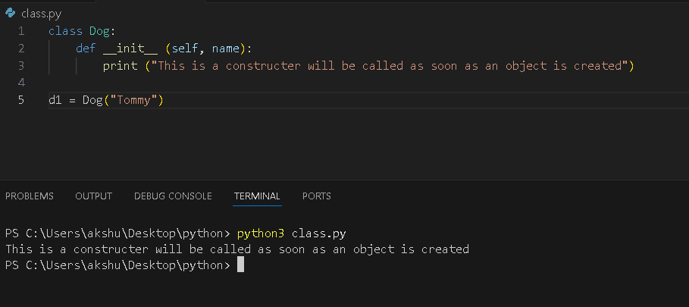
Proof that constructer will be called as soon as object is created

Slide 17
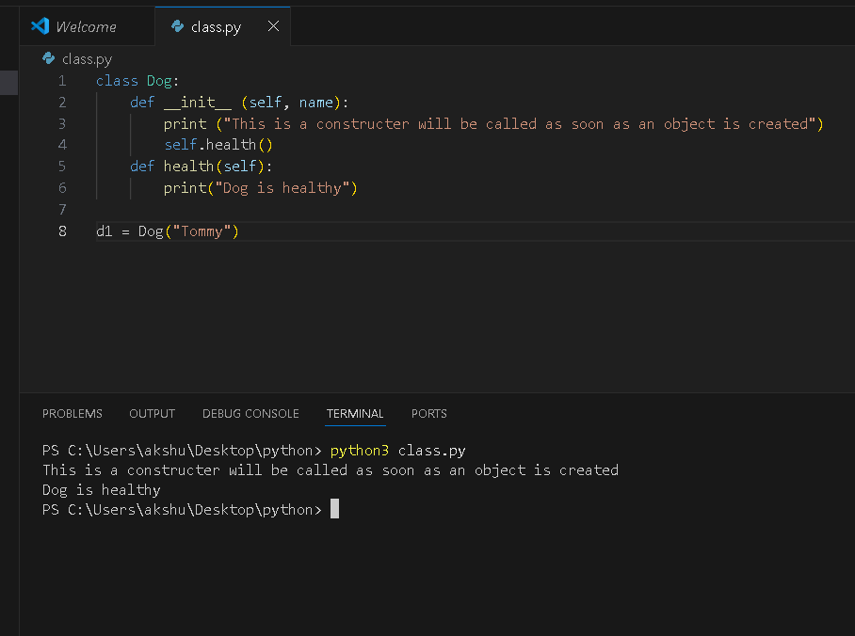
Proof that if you call
a method in constructor
It will also be executed
When you create object.

Slide 18
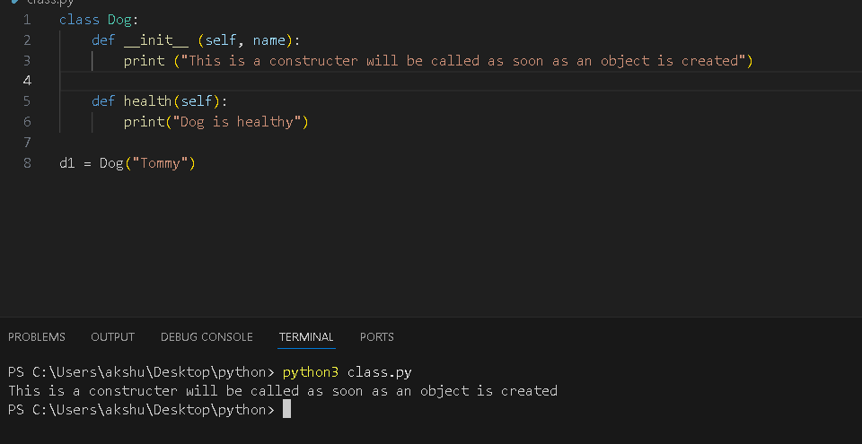
Proof that if you dont call
a method in constructor
It will not be executed
When you create object.

Slide 19
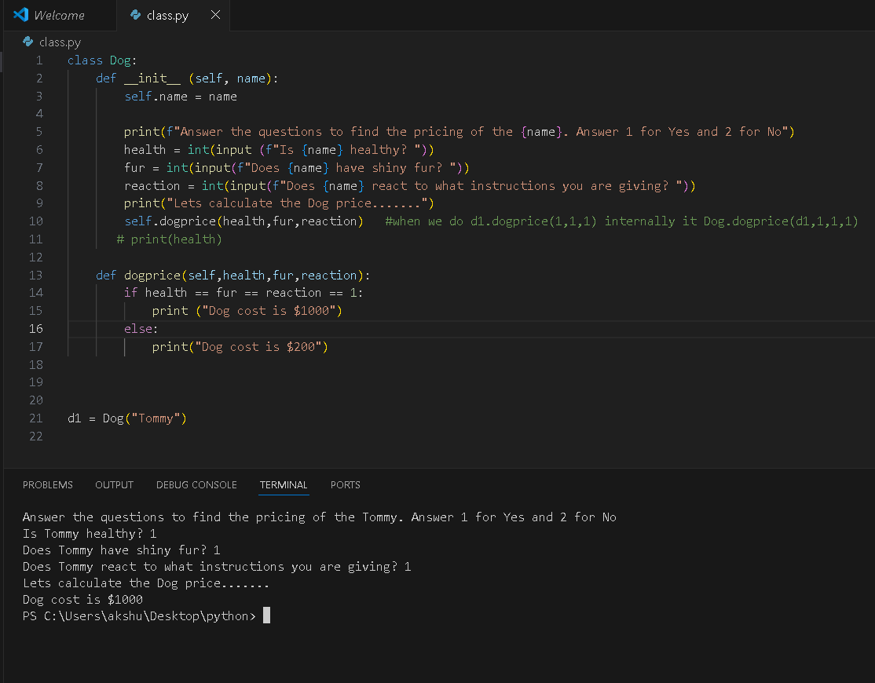
Dog pricing using class

